Slide 1

A Christ-Centered SEL & Leadership Formation Program
Bishop Diego High School • Grades 9-12

Slide 2
SOPHOMORE • GRADE 10
Understanding and Managing Anxiety
Provides psychoeducation on anxiety, distinguishing it from fear and stress. Students identify the physical sensations of anxiety, learn about the anxiety cycle and safety behaviors, and practice "Palm Tree Coping" skills to respond to triggers without avoidance.
CASEL FOCUS
Self-Management & Responsible Decision-Making
CST LENS
Option for the Vulnerable

Slide 3

Learning Objectives
Understanding and Managing Anxiety
Based on work by Dr. Andrea M. Kulberg PhD - www.anxietyexperts.com
Distinguish Anxiety from Fear and Stress
Understand how anxiety differs from fear (about actual threats) and stress (about real-life events)
1
Recognize Body Sensations of Anxiety
Identify normal physical responses that occur during anxiety and understand they are uncomfortable but not dangerous
2
Understand the Anxiety Cycle
Learn how avoidance, reassurance-seeking, and rituals can make anxiety worse over time
3
Practice Emotion Coaching Techniques
Develop "Palm Tree" coping skills to respond rather than react to emotional triggers
4

Slide 4
Understanding Anxiety
Key Definitions & Concepts
Based on work by Dr. Andrea M. Kulberg PhD - www.anxietyexperts.com
What is Anxiety?
Try and define Anxiety.
Anxiety vs. Fear
Anxiety vs. Stress
Anxiety
Fear
Anxiety
Stress
Anxiety is never dangerous, only uncomfortable. It is the MOST treatable mental health problem.

Slide 5
Understanding Anxiety
Key Definitions & Concepts
Based on work by Dr. Andrea M. Kulberg PhD - www.anxietyexperts.com
What is Anxiety?
"Anticipation of future threat, it's THOUGHTS and BODY SENSATIONS about what MIGHT happen."
Anxiety vs. Fear
Anxiety vs. Stress
Anxiety
Fear
Anxiety
Stress
About possible future threats
Response to actual present danger
Anticipatory worry about possibilities
Response to real life events building up
"What if something bad happens?"
"There is danger right now!"
Can occur without external stressors
Examples: loss, moving, divorce, poverty
Anxiety is never dangerous, only uncomfortable. It is the MOST treatable mental health problem.

Slide 6

Normal Body Sensations of Anxiety
Physical responses that are uncomfortable but never dangerous
Based on work by Dr. Andrea M. Kulberg PhD - www.anxietyexperts.com
Nausea or other GI symptoms
Tearfulness or emotional response
Racing heart or palpitations
Numbness or tingling in extremities
Sweating, hot/cold sensations
Feelings of unreality or detachment
Shallow breathing or choking sensation
Fear of dying or losing control
Trembling or shaking
Fear the anxiety will never end
PANIC = the catastrophic interpretation of these normal body sensations
Anxiety has a beginning, a peak, and a downward slope - it is always temporary!

Slide 7
Anxiety Floor Check
Stand next to the anxiety symptom you feel most when…
Based on work by Dr. Andrea M. Kulberg PhD - www.anxietyexperts.com
Nausea or other GI symptoms
Tearfulness or emotional response
Racing heart or palpitations
Numbness or tingling in extremities
Sweating, hot/cold sensations
Feelings of unreality or detachment
Shallow breathing or choking sensation
Fear of dying or losing control
Trembling or shaking
Fear the anxiety will never end
PANIC = the catastrophic interpretation of these normal body sensations
Anxiety has a beginning, a peak, and a downward slope - it is always temporary!
Notes:
Thinking about upcoming midterms or state assessments, worrying you'll blank out or fail.
Imagining presenting a project or speaking in class, fearing embarrassment or forgetting your lines.
Worrying about hanging out with a friend group or going to a party, fearing not fitting in or saying the wrong thing.
Thinking about the new school year—new teachers, classes and schedules, feeling out of control or unprepared.
5. Putting pressure on yourself to maintain high grades in every subject, afraid of not being 'enough.’
Anxiety Spectragram

Slide 8
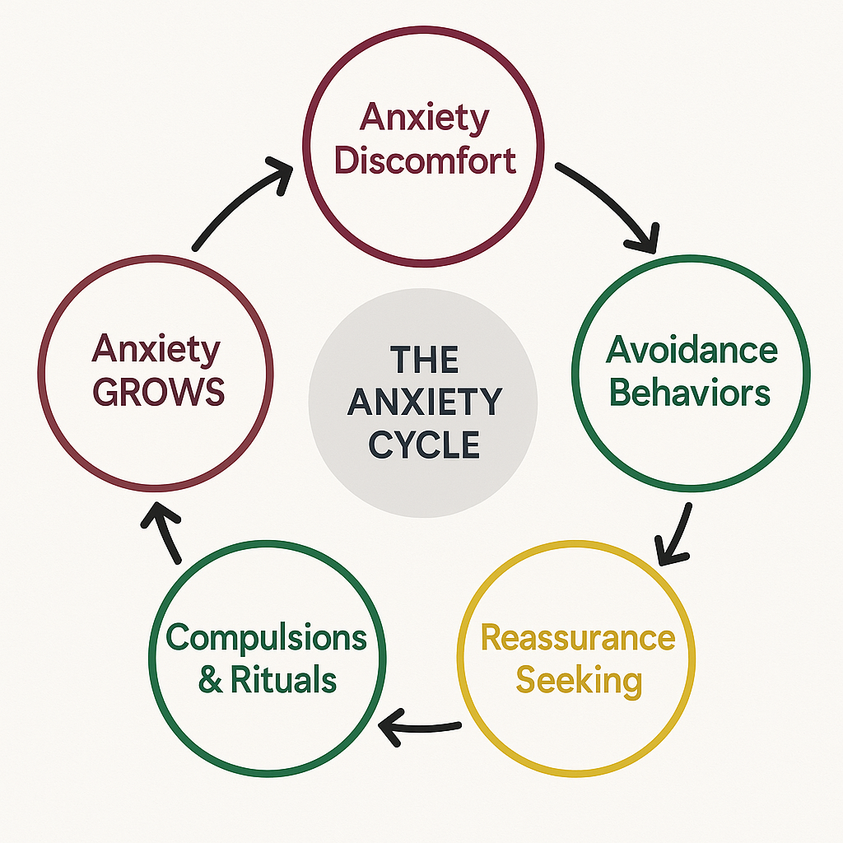
The Anxiety Cycle & Safety Behaviors
Understanding what maintains and grows anxiety
Based on work by Dr. Andrea M. Kulberg PhD - www.anxietyexperts.com
Safety Behaviors
Anxiety lives on three things that create the illusion of safety or certainty:
1. Avoidance
Staying away from anxiety-provoking situations
2. Reassurance-Seeking
Repeatedly asking for confirmation that everything will be okay
3. Compulsions/Rituals
Repeating behaviors to feel safe or prevent harm
"Any efforts to make anxiety go away GROW it."
You'll live in a smaller and smaller box!

Slide 9

Palm Tree Coping
Bend as the wind blows
Based on work by Dr. Andrea M. Kulberg PhD - www.anxietyexperts.com
The Palm Tree Metaphor
Cope with anxiety the way a palm tree copes with the wind:
Flexibly - bend but don't break Patiently - knowing it will pass
Confidently - designed to withstand storms
Embracing Uncertainty
Instead of seeking reassurance, try these responses:
3 Steps for Panic: MORE, MAYBE, MOVE
MORE: Tell the anxiety to intensify ("Bring it!")
MAYBE: Accept uncertainty ("Maybe something will happen, maybe not")
MOVE: Stay in the situation and proceed ("Do it anyway")
"Maybe, maybe not, we can't be sure" "There are no guarantees in life" "We'll have to see how it turns out"

Slide 10

Surf the Wave
Ride the wave until it ends
Based on work by Dr. Andrea M. Kulberg PhD - www.anxietyexperts.com
Surfing Metaphor
Cope with anxiety the way a surfer pursues a big wave:
Pursuing to hit it head on
Do it with a friend
Rid it to the end
Embracing Uncertainty
Instead of seeking reassurance, try these responses:
3 Steps for Panic: MORE, MAYBE, MOVE
MORE: Tell the anxiety to intensify ("Bring it!")
MAYBE: Accept uncertainty ("Maybe something will happen, maybe not")
MOVE: Stay in the situation and proceed ("Do it anyway")
"Maybe, maybe not, we can't be sure" "There are no guarantees in life" "We'll have to see how it turns out"

Slide 11
Feeling and Dealing in Relationship
Building empathy and emotional connection
Based on work by Dr. Andrea M. Kulberg PhD - www.anxietyexperts.com
What is Emotion Coaching?
"Emotion coaching is feeling WITH someone; CO-REGULATION of emotion"
A way to respond to someone experiencing an intense emotion that creates compassion, understanding, and de-escalation through validation. Emotion coached kids develop the capacity to validate their own emotions instead of acting out.
The Four Steps of Emotion Coaching
1
Mirror the complaint
Use the same volume and intensity as the person in distress
"Your anxious because…”
2
Validate
Help the person feel heard and understood “You make sense"
3
Empathize
Normalize and help label the feelings
"I imagine that feels…”
4
Help them “do it anyway” Be present and maintain behavioral expectations
"I'll get your backpack and walk with you to class"
Key Principle: Emotion coaching is moving TOWARD emotion so it can COMPLETE, not suppressing or fixing it.

Slide 12
Learning Objectives
Understanding and Managing Anxiety
Based on work by Dr. Andrea M. Kulberg PhD - www.anxietyexperts.com
Distinguish Anxiety from Fear and Stress
Understand how anxiety differs from fear (about actual threats) and stress (about real-life events)
1
Recognize Body Sensations of Anxiety
Identify normal physical responses that occur during anxiety and understand they are uncomfortable but not dangerous
2
Understand the Anxiety Cycle
Learn how avoidance, reassurance-seeking, and rituals can make anxiety worse over time
3
Practice Emotion Coaching Techniques
Develop "Palm Tree" coping skills to respond rather than react to emotional triggers
4

Slide 13






Gimkit
Gimkit Review Game
Directions: 1.) Go to gimkit.com/join.
2.) Enter the game code provided by your teacher or host.
3.) Click on the "Play Live" button to host a game from your dashboard or within a kit.
•
•
•
•

Slide 14
Questions?

